Slide 1
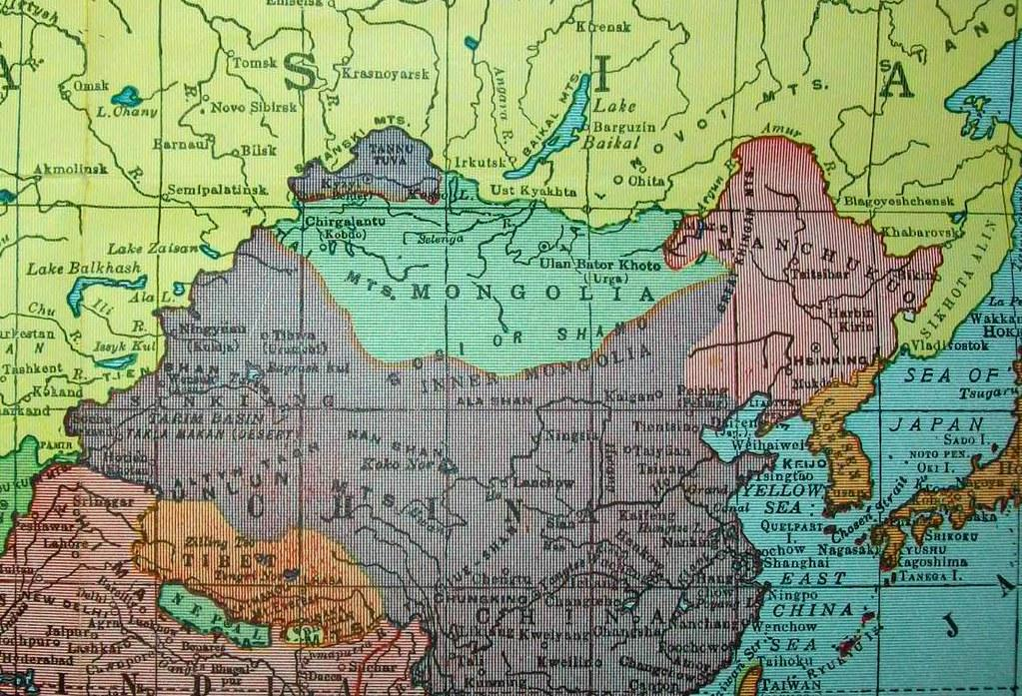
Incorporating East Asian Topics in Lesson Plans: Case Study on Taiwan
BY SHRUTHI NAGARAJAN
and AIKA OKISHIGE

Slide 2
Agenda/Timeline
10:10 am
10:25 am
10:30 am
10:40 am
Cultural Responsiveness
Assess yourself!
Lesson Plan
Resources
Culturally Responsive Teaching and its characteristics
Culturally Responsive Teacher
Assess your Cultural Responsiveness
Resource Spotlight: Book- Culturally Responsive teaching and the Brain
Culturally Responsive Lesson Plan
Example Lesson Plan
Sharing resources
Q&As

Slide 3
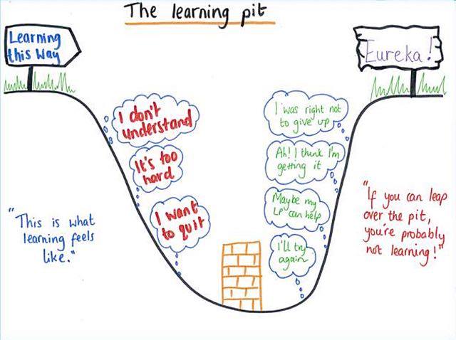
Culturally Responsive Teaching
A pedagogy that acknowledges, responds to, and celebrates fundamental cultures offers full, equitable access to education for students from all cultures.
Notes:
Culture is central to learning. It plays a role not only in communicating and receiving information, but also in shaping the thinking process of groups and individuals. Culturally Responsive Teaching is a pedagogy that recognizes the importance of including students' cultural references in all aspects of learning (Ladson-Billings,1994).

Slide 4
Characteristics of Culturally Responsive Teaching
Positive perspectives on parents and families
Communication of high expectations
Learning within the context of culture
Student-centered instruction
Culturally mediated instruction
Reshaping the curriculum
Teacher as facilitator
Resource Spotlight
15 Culturally-Relevant Teaching Strategies and Examples
Self-Audit your Culturally Competent Classroom (Pages 5-6)

Slide 5
Culturally Responsive Teacher
Get to know your Students
Make your classroom a judgement-free zone
Adapt your teaching
Include all cultures in your teaching
Assess your Cultural competence

Slide 6
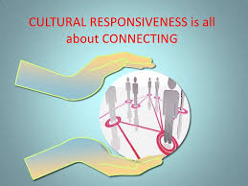
Assess your Cultural Responsiveness
Are you aware of your own cultural bias and behavior?
Are you ready to challenge any assumptions or stereotypes that you may hold?
Can you acknowledge how culture impacts the daily life and activities of students?
Can you understand how cultural norms influence communication?
Do you make an effort to learn about other cultures?
Can you effectively intervene when you see a student behaving in a discriminatory manner?
Are your teaching styles adaptable to students of multiple different cultures?
Do you allow for communication between you as your students' families?
Notes:
https://www.teachaway.com/blog/assessing-your-cultural-competence-checklist-culturally-responsive-teachers

Slide 7
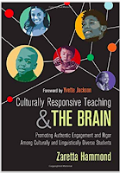
Culturally Responsive teaching and the Brain
Resource Spotlight!
Children make relationships and learn best in a welcoming environment, hostile or unwelcoming environments obstruct best possible learning.
Building positive relationships with students is essential to successful learning and development.
Stories, art, movement, and music help to make learning sticky. When learning is a dynamic action, students attend to that learning. Methods such as call and response, perplexity, questioning, and other attention grabbing techniques wake students up and invite them into the learning. Successful learners are able to direct their attention effectively towards the learning.
New learning must be connected to what we already know--we have to acknowledge what we know and then connect our new learning to that.
"To empower dependent learners and help them become independent learners, the brain needs to be challenged and stretched beyond its comfort zone with cognitive routines and strategies."- Zaretta Hammond

Slide 8
Culturally Responsive Lesson Plan
How does NRC create a lesson Plan?
List contemporary issues in East Asia relevant to the U.S.
Current News!
DMV school districts curriculum needs.
Grades- Students background knowledge.
Awareness of USA-East Asian countries relationship.
Teacher requests.
NOTE: Click the Logos to access the link to the websites!

Slide 9
Culturally Responsive Lesson Plan
How does NRC create a lesson Plan?
2. Create a lesson plan - Utilizing general information
Content of the Lesson Plan
Warm Up
Background knowledge
Whole Group Instruction
Use multiple resources to help diverse learners- videos, reading, activity, or podcast/audio.
Work Time/Small Group Instruction
Review/Reflection

Slide 10
Culturally Responsive
Lesson Plan
How does NRC create a lesson Plan?
3. Consult scholars and experts in the field
Discuss what relevant elements would be valuable for students to learn
Dive deeper into the issue and receive various perspectives on the topic
This specifically helps us build a more culturally responsive Lesson Plan- by avoiding bias, political-social issues, etc.
Ask if there are helpful and interesting resources (books, articles, and data, etc)
Review if the lesson plan is teacher/student friendly

Slide 11
Culturally Responsive
Lesson Plan
How does NRC create a lesson Plan?
5. Consult with teachers
Consulting teachers helps us make the lesson plan more teacher-friendly.
Evaluate if the lesson allow students to learn what they cannot solely learn from textbooks.
Helps us think from a teacher’s perspective.
Helps us understand teachers challenges on teaching East Asian subjects.
6. Publish on the NRC website!

Slide 12
Culturally Responsive
Lesson Plan Example
Example: Taiwan 228 incident
Podcast with a Taiwan visiting scholar on Taiwan 228 incident
Collect resources regarding Taiwan 228 incident and its influence
Consult with GW faculties in East Asian studies and receive various perspectives and insights
Design lessons focus with Taiwan 228
Notes:
at the podcast, we were able to receive one opinion on the Taiwan 228 incident. but we want the lesson plans allow the students to understand and think from various perspectives. So we asked many professors and incorporate various perspectives into the lesson plan.

Slide 13
Resources
East Asia National Resource Center- Podcasts, Skype-A-Scholar, Curriculum materials, Newsletter.
Global Resources Center at The George Washington University
35 Dumb Things Well-intended people say By Dr. Maura Cullen
Examining Inclusion- 10 Core Concepts of for your Leadership- Worksheet
East Asia and the World: Past and Present Lesson Plan Resources
THE MET- East Asia Artifacts- Online Museum
Global Taiwan Institute
Center for International Strategic Studies has numerous initiatives under its Asia Program
Brookings Institution's Center for East Asia Policy Studies

Slide 14
Resources
Brookings Institution's Center for East Asia Policy Studies
Project 2049 Institute
Heritage Foundation's Asia program
Carnegie Endowment for International Peace's Asia Program
United States Institute of Peace's Asia Center
American Enterprise Institute's Asia research
Center for New American Security's Asia-Pacific Security research
Institute for China-America Studies
Sejong Society of Washington, D.C.
Korea Economic Institute
US-Japan Research Institute

Slide 15
Contact Information
East Asia National Resource Center (https://nrc.elliott.gwu.edu/)
T: (202) 994-5886 | E: gweanrc@gwu.edu
Shruthi Shree Nagarajan
Curriculum Designer
snagara1@email.gwu.edu
Aika Okishige
Curriculum Designer
aika3oki@email.gwu.edu

