Slide 1
Webinar Norms
Participants are muted when they enter the webinar.
Use the chat box to ask or respond to questions during the presentation.
Webinar will be recorded, but participant names are not connected to images.
The chat box will not be included in the recording.

Slide 2
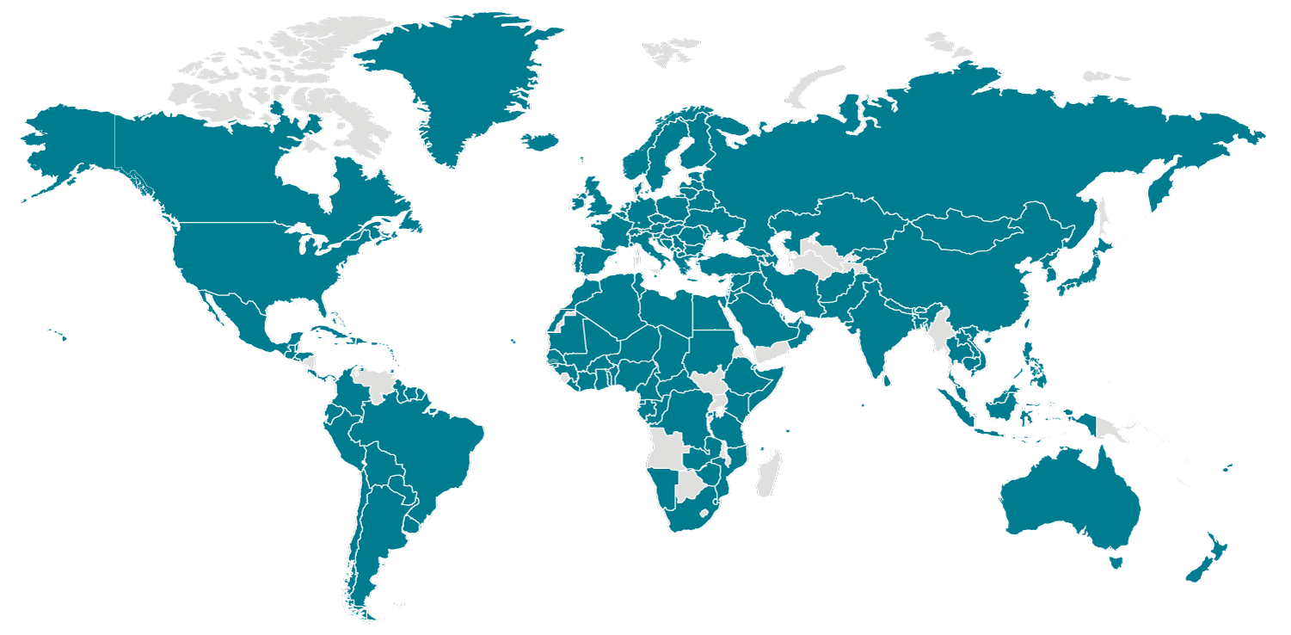
Global Views of COVID 19
Responses and Perspectives in China, Taiwan and Italy
Official U.S. CDC global map of countries with confirmed COVID-19 cases, as of March 30, 2020. Accessible at: https://www.cdc.gov/coronavirus/2019-ncov/cases-updates/world-map.html

Slide 3
Agenda
Introduction and Overview
“Understanding Coronavirus Responses in Different Cultures and Systems: Hopeful Views in China” presented by Huaying Bao and Dr. Qingyun Li
“Resolute Island in Turbulent Times: How Taiwan is Responding to the Novel Coronavirus Pandemic” presented by Dr. Eve Chiu
“Italy’s Struggle with COVID-19: A Clarion Call” presented by Dr. Giulio Pugliese
Q & A
Closing Poll
Resources & Future Professional Learning with UCB PDP

Slide 4
Introduction and Overview
ORIAS and UCB PD Providers
East Asia National Resource Center
Opening Poll

Slide 5
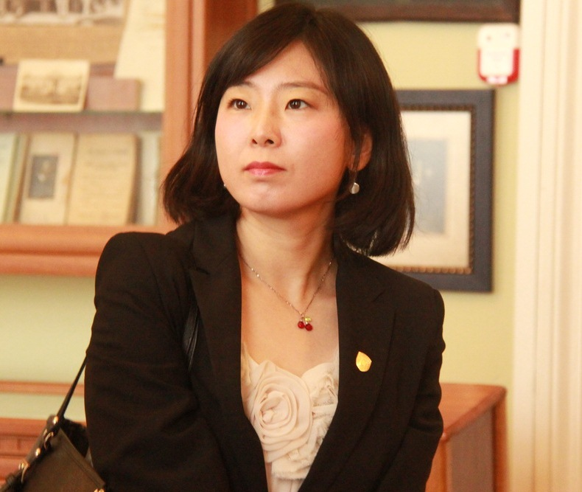
Combatting COVID-19 : China’s Experiences and the Disease’s Impact on China
presented by Huaying Bao and Dr. Qingyun Li
Huaying Bao is the Chief of Division for International Exchange, International Exchange and Cooperation Office at Beijing Foreign Studies University, where she focuses on comparative cultural diplomacy, and immigration. At the NRC, she is studying cultural exchange strategies between China and the U.S. in order to improve Sino-U.S. Relations. Ms. Bao will survey the existing cultural diplomacy of both countries from the establishment of their diplomatic relations in 1979, then propose strategies to resolve the challenges posed by ongoing trade disputes. In addition to faculty at GWU, she will be working with professors from American University to broaden the scope of her research.

Slide 6
Combatting COVID-19 : China’s Experiences and the Disease’s Impact on China
Huaying Bao
Visiting Scholar, East Asia National Resource Center, Elliott School of International Affairs
Division Chief for International Exchange and Cooperation, Beijing Foreign Studies University

Slide 7
Outline
1. Updates of COVID-19 in China - Healing in Phases
2. Combatting COVID-19: China’s Measures
3. The Economic Impact of COVID-19 on China
4. The Impact of COVID-19 on China as a Global Power
5. Conclusion

Slide 8
Updates of COVID-19 in China - Healing in Phases
Covid-19 cases update
Business and industries gradually recover
China began to share experience and provide medical supplies to other countries

Slide 9
China’s Measures on Overcoming COVID-19
Shutdown of Wuhan City and travel restrictions nationwide
An all-in engagement of the whole society
Incredibly high output on producing medical facilities and supplies
Use of technology
Self-quarantine of the whole public

Slide 10
The “China Model”
A “whole-of government” and “whole-of-society” approach

Slide 11
The Economic Impact of COVID-19 on China
1.COVID-19’s attack on China’s Economy
2.China’s Economic Recovery
3. An Optimistic Economic Expectation in the Rest of the Year

Slide 12
The Impact of COVID-19 on China as a Global Power
Positive impact:
1) China’s effective containment of the pandemic shows its strength;
2) China provides valuable experience and medical aid to the world;
3) China receives recognition and appreciation from the world.

Slide 13
The Impact of COVID-19 on China as a Global Power
“a responsible global player”
- Ambassador Liu Xiaoming

Slide 14
The Impact of COVID-19 on China as a Global Power
2. Negative impact:
1) Criticism from the international community:
A delayed response from the Chinese government at the initial stage
Dr. Li Wenliang “the whistle-blower” death
Violation of human rights on the lock-down of Wuhan city

Slide 15
The Impact of COVID-19 on China as a Global Power
2) Donald Trump on the “Chinese Virus”
3) “De-Sinicization” of the world supply chain
4) A Western alert: a competition for the world leadership?

Slide 16
Conclusion
Covid-19 will reshape the world order

Slide 17
THANK YOU!

Slide 18
Understanding Coronavirus Responses in Different Cultures and Systems:
Hopeful Views in China
presented by Huaying Bao and Dr. Qingyun Li
Dr. Qingyun Li is an Associate Research Professor of Chinese Politics at the Shanghai Academy of Social Sciences. Her Areas of Expertise are on the theory and practice of Socialism with Chinese Characteristics, as well as the history of Chinese Communist Party. Her current research examines China in the Xi Jinping Era, implications on the international order, and the significance of the theory and practice of socialism with Chinese characteristics for China and its impact internationally. Dr. Qingyun Li was a visiting scholar at China Center, the University of Oxford, UK(2015-2016). She is also a nonresident scholar at the Sigur Center for Asian Studies, Elliott School of International Affairs, the George Washington University (2018-2021).

Slide 19
Understanding Coronavirus Responses in Different Cultures and Systems: Hopeful Views in China
Qingyun Li
East Asia Voices Initiative Fellow, GW
Associate Research Professor, Shanghai Academy of Social Sciences

Slide 20
Overview
What domestic cultural norms in China contributed to the country's response in addressing the novel Coronavirus spread?
What are the negative aspects of Chinese system?

Slide 21
Cultural Norms in China
What domestic cultural norms in China contributed to the country's response in addressing the novel Coronavirus spread?
Chinese traditional culture
China's social ethical order
The Red culture, Red Gene
Core socialist values

Slide 22
Cultural Norms in China
Chinese traditional culture
Chinese traditional culture with Confucianism as its main context. It advocates the consciousness of every person is responsible for the rise and fall of the world, and emphasizes love and loyalty to the country, emphasizes respect for authority, social stability, and national interests over individualism.
China's social ethical order
Chinese society has a profound belief that everyone is a family and the entire society is a big family. The sense of national identity and cohesion makes Chinese people willing to live and die together, share difficulties, and fight against the Coronavirus together.
The Red Culture, Red Gene
The red culture was formed during the Chinese revolution. It advocates the confidence of overcoming difficulties, the heroic spirit of winning the wars, the sacrificial spirit , and the concept of military iron discipline, etc. It built the modern Chinese spirit, values and power.
Core socialist values
Chinese society is now a society led by socialist core values, which are the mainstream values of the present day Chinese society and people. Guided by the core socialist values, Chinese people have faith, the country has strength and the nation has hope.

Slide 23
The negative aspects of Chinese system
What are the negative aspect of Chinese system?
Bureaucracy
Viruses have no borders

Slide 24
Conclusion
Only cooperation can defeat the virus.
China will assume the responsibilities of a great power and help others.

Slide 25
Thank you

Slide 26
Resolute Island in Turbulent Times:
How Taiwan is Responding to the Novel Coronavirus Pandemic
presented by Dr. Eve Chiu
Dr. Eve Chiu is a Fulbright grantee and CEO of The Foundation for Excellent Journalism Award in Taiwan, which awards prizes to outstanding journalists annually for improving the quality of news media in Taiwan. Dr. Chiu served as an award-winning journalist for more than 10 years, and has published more than a dozen formal research papers on media, communication, and freedom of speech. Dr. Chiu also a board member of PTS (Public Television Service) of Taiwan, and is a regular consultant for the National Communication Commission (NCC) as well as the Ministry of Culture.

Slide 27
Resolute Island in Turbulent Times:
How Taiwan is Responding to the Novel Coronavirus Pandemic
Global Views on COVID 19: Responses and Perspectives in China, Taiwan & Italy
A Webinar Series
3/30 2020
Dr. EVE CHIU
Visiting Scholar, East Asia Voices Initiative Fellow of GWU
CEO, The Foundation for Excellent Journalism Award, Taiwan

Slide 28
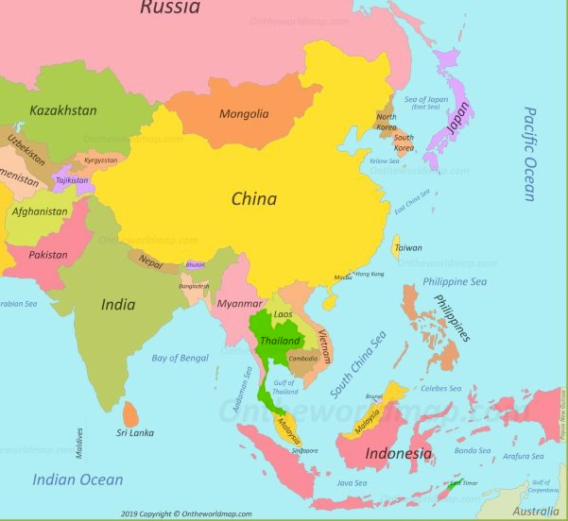
Always overvalue the enemy——Sun Tzu, The Art of War
Taiwan is 130 kilometers from China,
Taiwan Strait in between, and more than
400,000 Taiwanese people work in China, not including many students and tourists who flow frequently crossing the Strait. Therefore Taiwan was predicted to be one of the hardest hit locations of the novel coronavirus pandemic, though the subsequent flow of events tells quite another story.
The Self Identity of Taiwanese People
under the Pandemic (released 2/24, 2020)

Slide 29
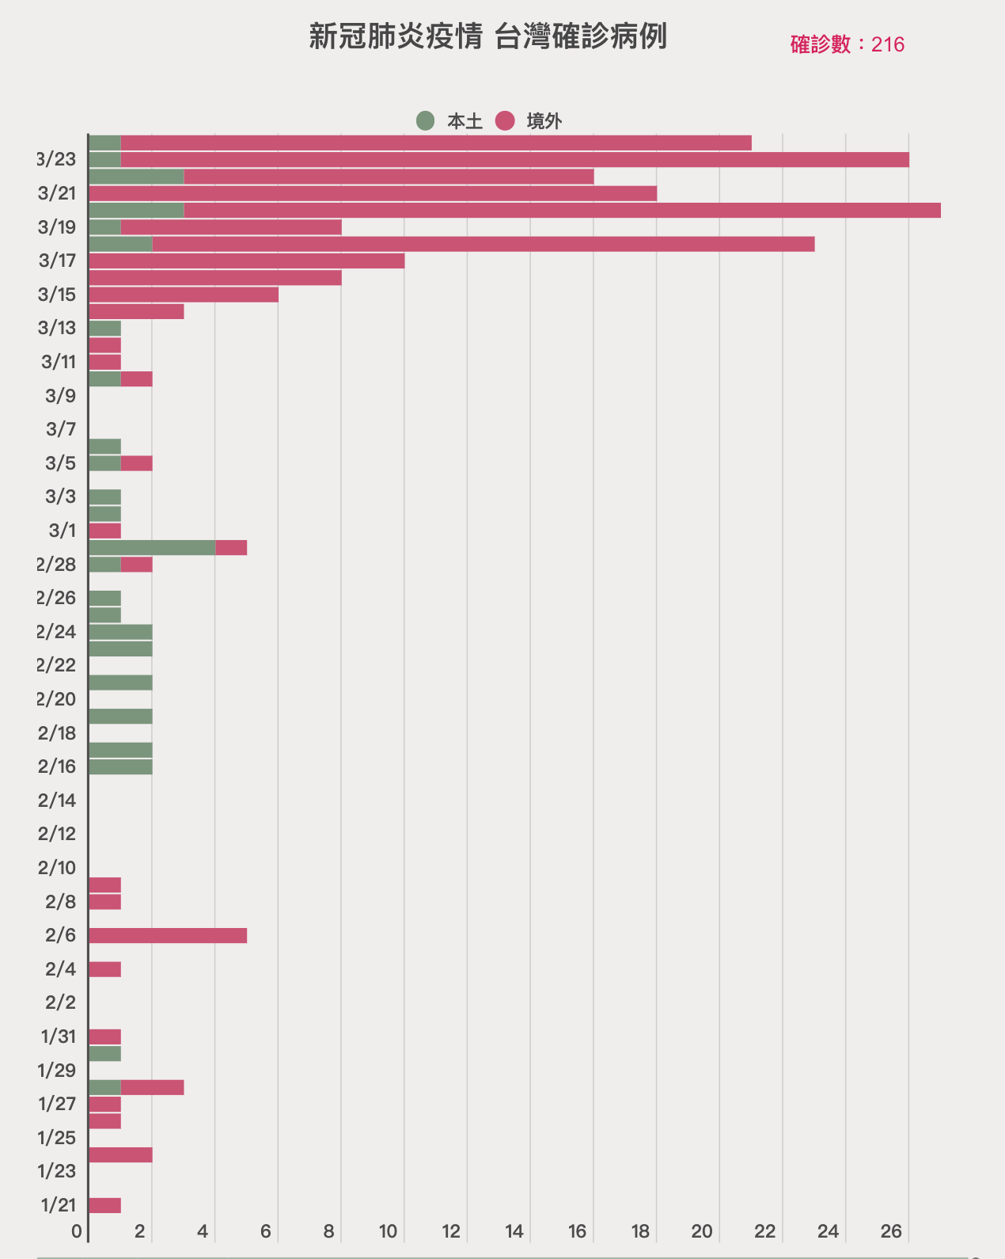
Local infected
Laboratory Accuracy Tracking
Moved in
Countries’ official statics by 3/20
(made by Dr. Chen Chien-jen)
Closed the border to foreigners
Countries | Positive per 1,000 | Cases per100,000 | Dead toll per 100
United Arab Emirates | 0.8 | 1.20 | 0.00
Russia | 1.2 | 0.14 | 0.50
Taiwan | 5.0 | 0.45 | 0.93
Australia | 6.9 | 2.88 | 0.85
Canada | 12.2 | 2.32 | 1.38
South Korea | 27.9 | 16.64 | 1.10
UK | 38.7 | 3.95 | 5.48
Norway | 49.9 | 33.17 | 0.39
Japan | 56.5 | 0.76 | 3.43
Belgian | 80.9 | 15.53 | 1.17
US | 101.1 | 4.16 | 1.47
France | 167.4 | 16.54 | 3.41
Italy | 202.8 | 68.41 | 8.30
Three cases all traveled to Europe
Launched a pneumonia national survey and found out the cab driver
Closed the border to China
First case found on the plane from Wuhan

Slide 30
02.14
Surveyed all not flu
caused pneumonia
and found a cab
driver tested positive
from 113 patients
in whole country
2020.01.15
Started to prepare a person
to person epidemic when
China said it is not sure
to pass among people
03.24
Those required to do quarantine
and isolation without wages or
salary will get subsidy $33 per day
01.24
Medical masks export
ban announced
01.20
Set upCommand
center for unified order
02.06
Mask ration
Launched
People ’s normal life keeps going on when a small
part of schools and businesses closed or run
remotely for necessary quarantine and isolation.
2019.12.31
Quarantine officers boarded the planes from Wuhan
01.21
First case found
on the plane
from Wuhan
03.13
Taiwan congress passed
a $2 billions bill to deal
with the virus fighting
03.25
More than 500 outdoor/100
indoor events are suggested to stop
02.06
Closed the border to
China for more than
20,000 cases there
01.17
Sent two experts
to China for more
information
03.19
Closed the border
to all foreigners

Slide 31
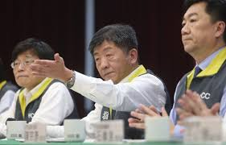
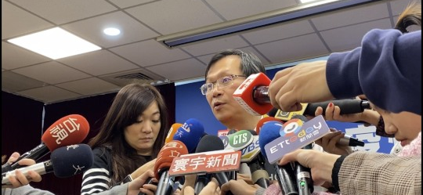
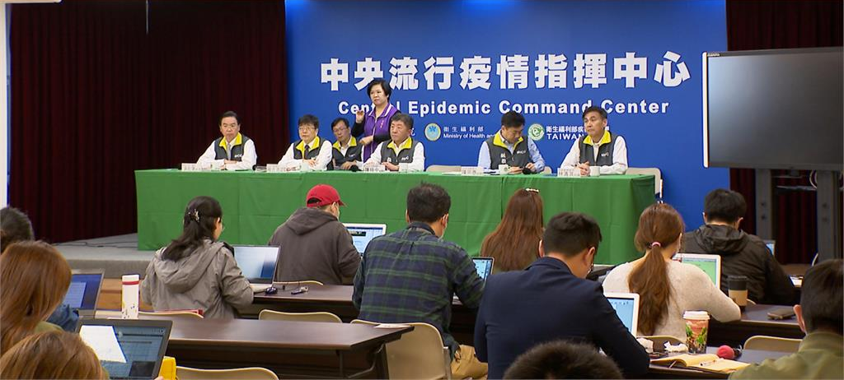
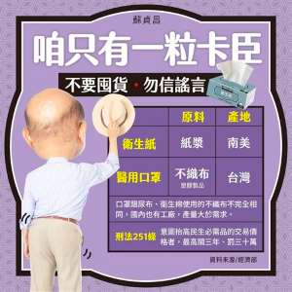

Slide 32
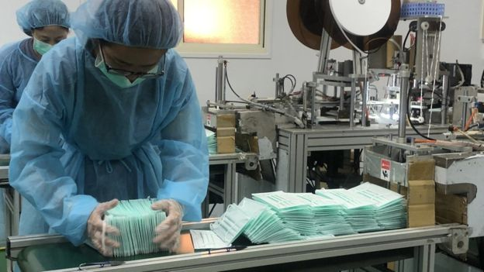
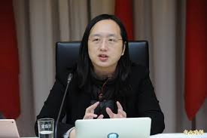
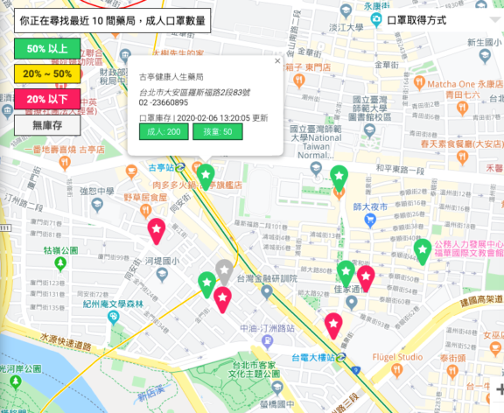
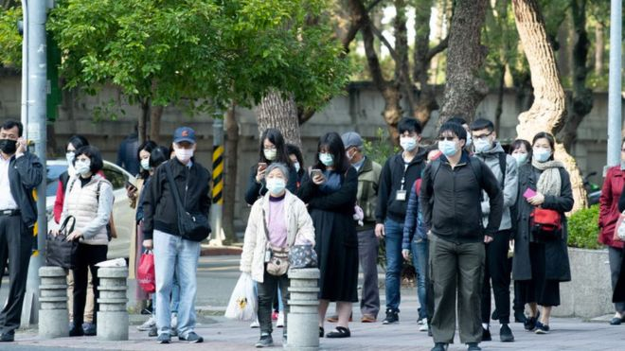
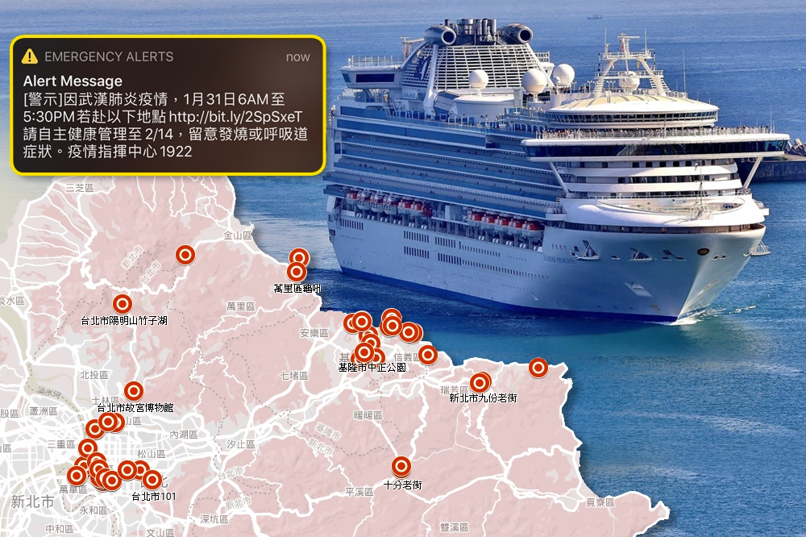
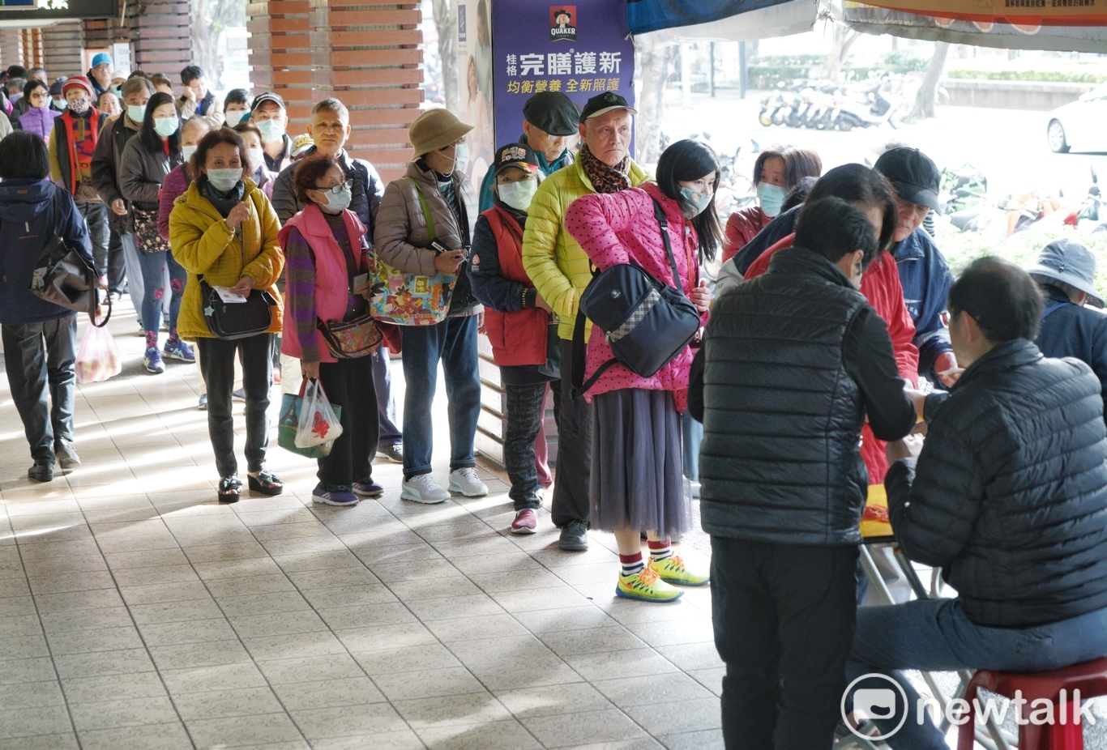
About medical mask
Producing: In the beginning, Taiwan had 4 million per day producing capability when stop exportation. Taiwan government bought machines and set up speedily to make factories raising their producing number in sort time, now is 10 millions per day.
Dispensing: No exporting, centralized distribution, rationing, buy online, information crystallization
One of the Digital Mask Maps made by citizens
Map of Dimond Princess tourists tracks

Slide 33
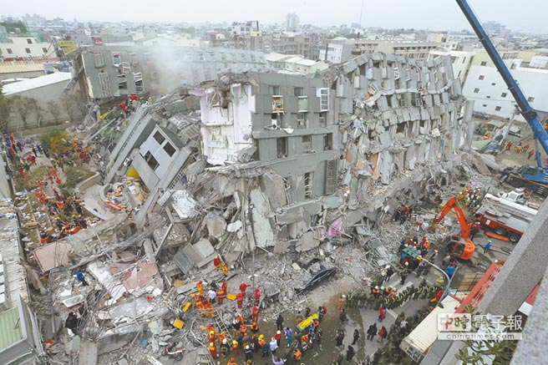
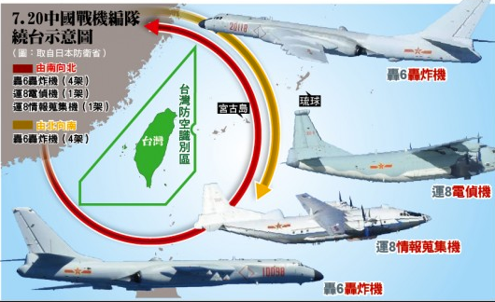
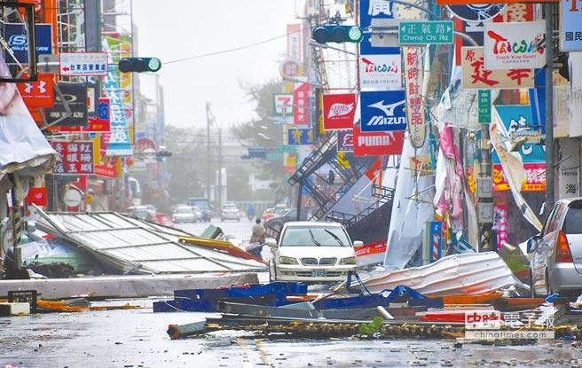
How can Taiwan do this?
Historical and geographic context:
Took decisive action early on:
Fully covered health insurance:
Taiwan has earthquakes, typhoons often, and is always preparing for war in past seven decades for the military threat from China, so people here are always under caution and awareness of crisis
Made the “person to person” epidemic
judgement in the very beginning and
started advanced deployment. Taiwan has more experience than many countries to do the information illustration from China and had learned its lesson from the 2003 SARS epidemic. On board quarantine check and pneumonia proactive survey dig out the diving cases which prevented more local effected cases.
More than 99% people of Taiwan
covered by public run health
insurance, with monthly payment less than $40 per person, and the virus test is free under doctor’s instruction. So the sufficient data
can be used to trace all medical treatments which means to trace the virus. By the data available, Taiwan launched a for mask ration for pharmacies, three per week per person

Slide 34
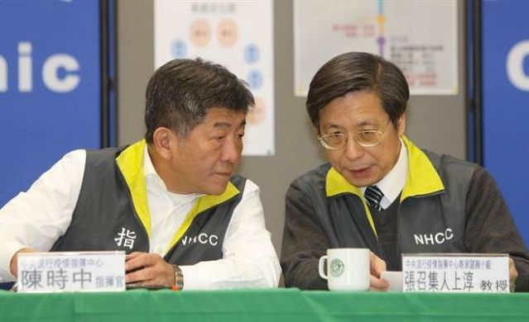
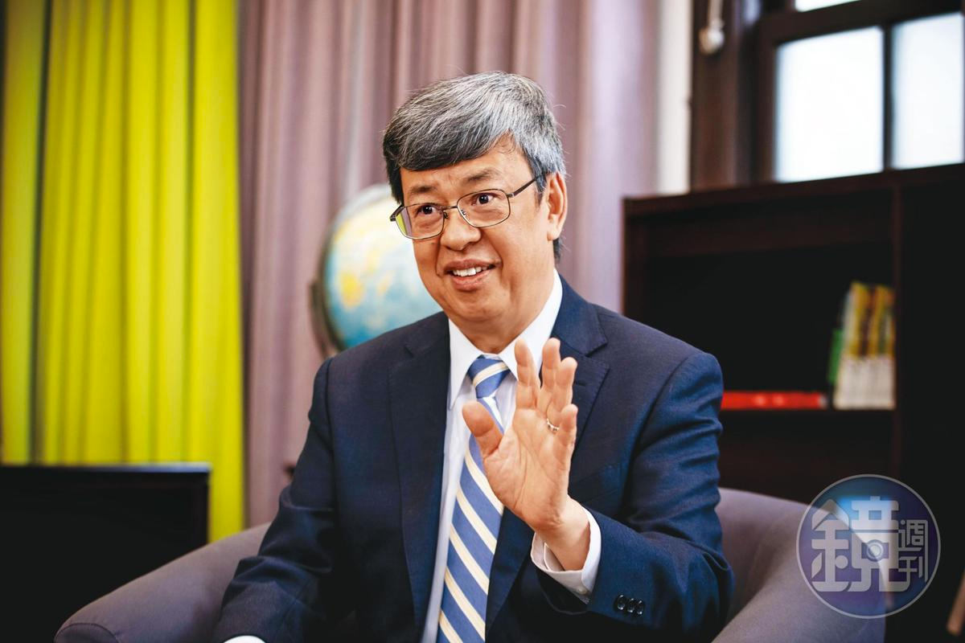
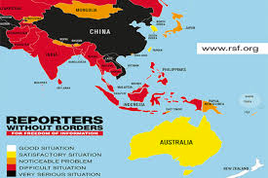
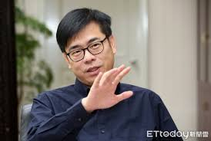
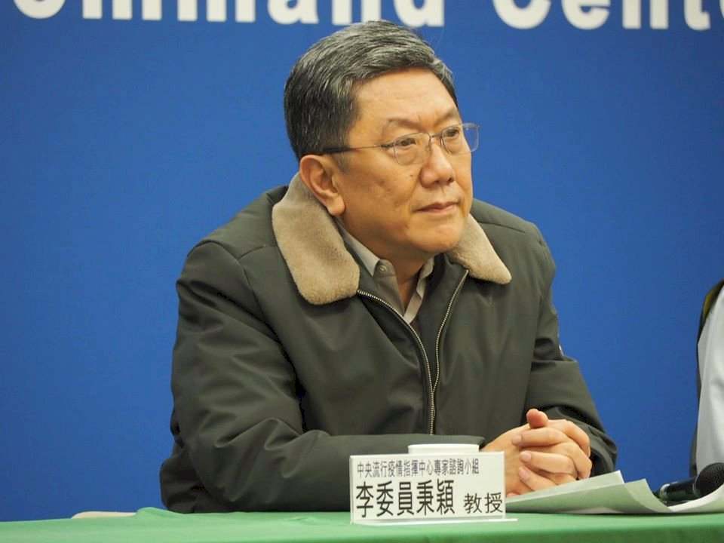
How can Taiwan do this?
Give way to the experts who know best
Free media and access to information
The core members of the Command Center with a supporting experts team are all well medical trained including the vice president, a deputy prime minister, a minister, and many public health or medical professors whom, with power authorized by the President and the Prime minster, are able to make expeditious decisions at the frontlines.
Taiwan is one of the countries in Asia with a high degree of press freedom. Its ranking of 2019 is 42nd, next to South Korea 41st, when US is 48th. Quality and responsible reporting from various free media helps people under crisis take correct measures and strengthens the legitimacy, credibility, and reliability of government-sanctioned actions.
2019 World Press Freedom Index

Slide 35
Human rights concern when conquering the virus
We want to trace the virus, which means we have to trace people – which leads to a privacy rights issue.
The pandemic challenges the subtle and obscure boundary between individual liberty and public interests which itself contributes to individual goods.
Most of Taiwan public opinion supports strengthening measurements for the outbreak, but there are some critics who challenge the government’s actions
1. Using personal health insurance data to do mask rationing
2. Tracing the people who have travelled overseas or had contact with positive cases who should quarantine themselves but might not do so.
Human rights NGOs in Taiwan are launching campaign for a legislative action to clarify an emergent usage limitation of governmental power during this and other such crises.
In a democracy like the USA or Taiwan, with free press and information openness, every public issue is debatable. However, through debate and social dialogue, our democracies set up deeper and stronger.
Bottom Line: Important to conquer the outbreak with legitimacy and human rights protection

Slide 36
Conclusion
“You can contain clusters,” Dr. David L. Heymann said. “You need to identify and stop discrete outbreaks, and then do rigorous contact tracing.” Easier said than done, though: “Doing so takes intelligent, rapidly adaptive work by health officials, and near-total cooperation from the populace,” David explains.
~The New York Times March 23
What has helped Taiwan be among the success stories of dealing with this outbreak:
Previewing of the outbreak ahead of time and initiating early deployment of public health assets/measures
An experts-led united commend center with laboratory-level accurate case tracking
Digital data power by full coverage health insurance
Active cooperation from a well-informed populace that views government responses as credible and legitimate
A successful epidemic prevention needs to include:
Social and individual perspectives
An overarching master public health plan, with medical expertise and related medical technology support.
Taiwan anticipates a second peak after citizens return home from travel overseas, but with the measures it has taken, Taiwan stands poised to continue addressing this public health challenge.

Slide 37
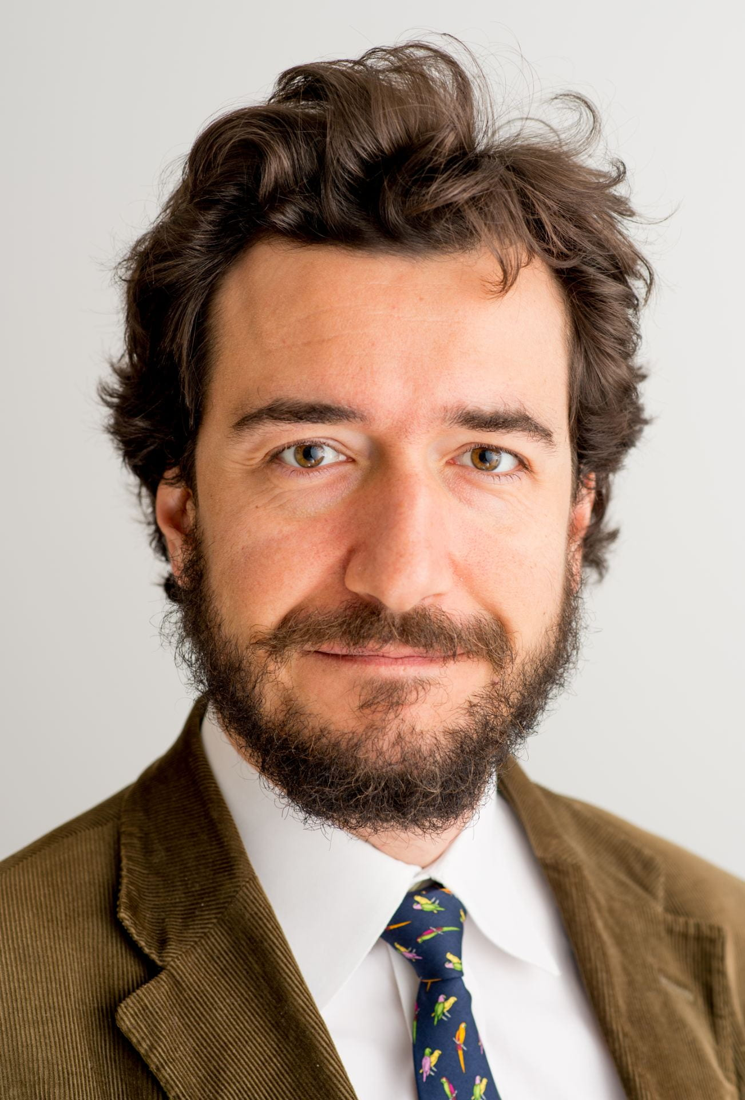
Italy’s Struggle with COVID-19:
A Clarion Call
presented by Dr. Giulio Pugliese
Dr. Giulio Pugliese specializes in the politics, both domestic and international, of the Asia-Pacific with a focus on Japan, China and the United States. He has presented at a variety of venues, and published articles and contributing chapters concerning academic, policy-oriented and commercial themes in Italy, the U.S. and Japan. He co-authored a book, Sino-Japanese Power Politics: Might, Money and Minds (Palgrave MacMillan, 2017. He has completed his Ph.D. work at the University of Cambridge after extensive fieldwork in Tokyo, where Giulio was based at the National Graduate Research Institute for Policy Studies (GRIPS). Dr. Pugliese is a regular contributor to and member of the editorial board of Asia Maior, Italy’s leading academic publication on current Asian affairs.

Slide 38
Italy’s Struggle with COVID-19: A Clarion Call to the United States
Dr. Giulio Pugliese – Lecturer in War Studies, King’s College London Twitter Handle: @PugliesAsia
30 March 2020

Slide 39
A clarion call for US action
First Western liberal democracy to confront COVID-19
no recent experience with Coronaviruses (≠China, Taiwan, South Korea)
social and living practice ≠ Northeast Asia (e.g. multigenerational households)
Balancing act: health & safety, economic and political considerations
cognitive biases and different priorities (e.g. welfare state vs. neoliberal state)
strict measures politically hard to enforce at early stage
COVID-19 overwhelms Northern Italy’s advanced health-care system
10k+ deaths = biggest crisis since World War II

Slide 40
From Mitigation to Suppression
Strategies of suppression ≠ mitigation
A fragmented decision-making breeds stop-gap measures:
politicization and central-local divide
selective, indecisive move to establish local «cordon sanitaires»
virus spreads more easily: risk of domino-effect
Need for coordinated and aggressive action
Need to learn from virtuous and negative examples
(e.g. aggressive tests aimed at community spread)
Strategy of suppression: state-wide quarantine
Self-isolation, lockdown, out only for essential businesses
Weaker healthcare system overwhelmed? How and when to lift the quarantine?

Slide 41
A clarion call for constructive US leadership
Intensified US-China rivalry: lack of meaningful cooperation extends to zero-sum battle for «hearts and minds» -- “US bioweapon vs. Wuhan/Chinese virus”
Biggest crisis since World War II for many countries:
China’s early responsibilities for pandemic not forgotten
US initial international response underwhelming
Italy as main battleground of «medical aid» diplomacy: responses will be long remembered
China’s medical help fills a leadership vacuum?
US aid actually underreported: US public diplomacy to the rescue
But best to avoid zero-sum narratives and deep antagonism
Slippery slope of COVID-19 crisis becoming a key rupture point in US-China relations

Slide 42
Question and Answer Period

Slide 43
Closing Poll

Slide 44
UCB Resources
UC Berkeley PD Providers have prepared a page of resources for educators, including:
Public Health Resources
Worker Resources
Mental Health/Self Care Resources
Remote Learning Resources
Resources for Supporting Students with Disabilities
Resource list available here: https://tinyurl.com/u5ko9zk

Slide 45
GW Resources
The GW East Asia NRC is developing a set of digital resources for educators, scholars, and students to engage in contemporary issues in East Asia, including:
East Asia Hotspots podcast series
Lesson plans and other curriculum materials
Teacher training workshops and workshop publications
Opportunities to set up virtual lectures with scholars
Bi-weekly K-12 teacher newsletter, sign up here!
Resource list available here: https://nrc.elliott.gwu.edu/k-12-global-competencies-program/

Slide 46
Future Professional Learning with UCBPDP
How often do you have time for new learning and deep reflection?
Are you worried that all this talk about “instant” distance learning solutions will move us away from established best practices in the field?
Going stir crazy at home and want to engage your mind and spirit?
UC Berkeley’s Professional Development Providers are offering FREE online professional learning sessions for educators.
Attend sessions with experts from across our network and enhance your practice.
A calendar of offerings available here http://bit.ly/BerkeleyPDP

