Slide 1
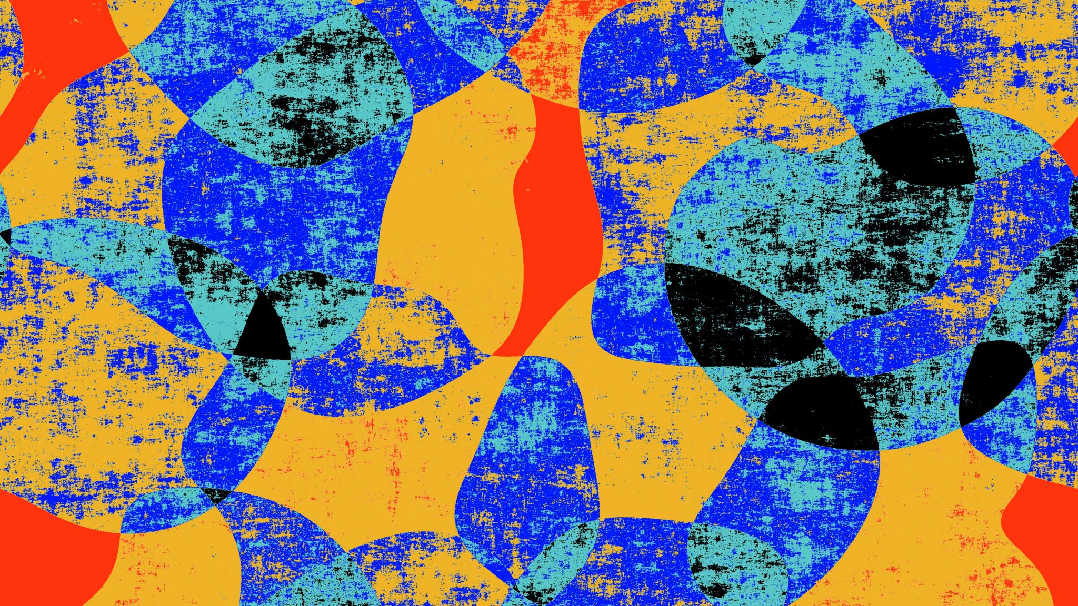
Silk Road and Globalization
By Shruthi Nagarajan
NRC Curriculum Developer

Slide 2
What is the Silk Road?
Overview
The Silk Road was a vast trade network connecting Eurasia and North Africa via land and sea routes.
The Silk Road earned its name from Chinese silk, a highly valued commodity that merchants transported along these trade networks.
Advances in technology and increased political stability caused an increase in trade. The opening of more trade routes caused travelers to exchange many things: animals, spices, ideas, and diseases.
Watch the Video: The Silk Road
(Note: After watching the video students can complete the Silk Road Module on Khan Academy.)
Review Glossary terms (See Resource Guide Handout 1: Glossary Terms, pg. 8.)

Slide 3
Goods and Services Traded via Silk Road
Activity Time
In groups of 2-3, students will put on their researcher hats and answer the below questions:
1. How did trade take place (modes of transportation, currency, etc.)?
2. Apart from the trade of goods, what else was transferred via silk road (art, religion, diseases language, etc.)?
(Students are encouraged to look at current events, items that they see in their everyday life)
Come back as a large group and discuss/share findings.
Notes:
Note to teacher: Review activity before showing the list on the next slide.

Slide 4
Notes:
Review this image post the previous activity.

Slide 5
The New Silk Road
Watch the documentary on
‘The New Silk Road’
https://www.channelnewsasia.com/news/video-on-demand/new-silk-road
Handout 2: Watch the Video and Answer the following questions, pg. 9 to 11
Take home assignment
Answer the questions-
Draw the New Silk Road Route (see Handout 3, pg. 13)
How is it different from the Old Silk Road?
What are the major goods and services traded?

Slide 6
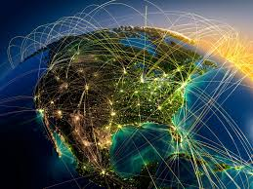
Globalization
Globalization? Globalization refers to the circulation of goods and products internationally.
Even though the Silk Road was not the first trade route, it pioneered Globalization starting from the 2nd Century BCE.
Look at the label of the cloth you are wearing - it is most likely made in a country miles away from the United States. It is traveled across seas before it landed in your wardrobe.

Slide 7
Activity Time
Think-Pair-Share
Students are grouped to research the goods that are available in the USA as a result of the New Silk Road.
Each group will share their findings and discuss-
‘How has the global economy shaped the USA?’.

Slide 8
Reflection/Debrief
Any questions/clarification?
Exit Ticket:
What is one valuable thing you learned in this topic?
In your opinion, is Globalization a boon or a curse? Explain.

Slide 9
Resources
Interactive maps
World Map (https://worldmap.harvard.edu/maps/5079)
Cities along the Silk Road (https://en.unesco.org/silkroad/network-silk-road-cities-map-app/en)
Interactive Silk Road Map Exercise (https://depts.washington.edu/silkroad/maps/mapquiz/mapquiz.html)
Video Resources
Early Silk Road (https://www.youtube.com/watch?v=lLeIclx2lAU)
The Silk Road: Connecting the ancient world through trade (https://www.youtube.com/watch?v=vn3e37VWc0k)
How The Ancient Silk Road Pioneered Globalization (https://www.youtube.com/watch?v=cHSgkZsCgtw)
Silk Road Trade Goods (https://www.youtube.com/watch?v=8VEVZJ6-4JQ)
Books
A New History of the World By Peter Frankopan
Religions of the Silk Road: Premodern Patterns of Globalization by Richard Foltz
The Global Silk Road: Globalization, Islam and the Creation and Distribution of Knowledge Using the Internet by Brian Hilton, CHong Ju Choi, and Carla Millar

Slide 10
Resources
Articles
Silk Road: A Glance at Archaic Globalization (https://iwp.uiowa.edu/silkroutes/city/kolkata/text/silk-road-glance-archaic-globalization)
Geography Along the Silk Road (http://www.chinainstitute.cieducationportal.org/cimain/wp-content/themes/chinainstitute/pdfs/education/fromsilktooil_pdf3.pdf)
Ethnic Relations and Political History Along The Silk Roads (http://www.chinainstitute.cieducationportal.org/cimain/wp-content/themes/chinainstitute/pdfs/education/fromsilktooil_pdf4.pdf)
Exchange of Goods and Ideas Along The Silk Roads (http://www.chinainstitute.cieducationportal.org/cimain/wp-content/themes/chinainstitute/pdfs/education/fromsilktooil_pdf5.pdf)
Religions Along the Silk Road (http://www.chinainstitute.cieducationportal.org/cimain/wp-content/themes/chinainstitute/pdfs/education/fromsilktooil_pdf6.pdf)
Art Along the Silk Road (http://www.chinainstitute.cieducationportal.org/cimain/wp-content/themes/chinainstitute/pdfs/education/fromsilktooil_pdf7.pdf)
The Silk Roads: Globalization before neoliberalization: Introduction to the special issue (https://journals.sagepub.com/doi/full/10.1177/2057891118793735)
The history of Supply Chain From the Silk Road to Globalization (https://medium.com/@marcellvollmer/the-history-of-supply-chain-from-the-silk-road-to-globalization-845e6e4733ce)
The Silk Road and its impact on globalization (https://www.casa-arts.org/cms/lib/PA01925203/Centricity/Domain/54/the-silk-road-and-globalization.pdf)
The New Silk Road, Old Concepts of Globalization, and New Questions (https://www.researchgate.net/publication/321260954_The_New_Silk_Road_Old_Concepts_of_Globalization_and_New_Questions)

